Slide 1

Emerging Technology Training for a Seamless Digital Transformation

Slide 2
Cognixia is a leading Emerging Technologies Training Provider
Cognixia, an AWARD
WINNING training
arm of Collabera
Delivered trainings
in 15+ countries
75000+
PROFESSIONALS
Trained world-wide
450+ CLIENTS
across the globe
400+ Trainers
BEST IN CLASS TRAININGS on Emerging Technologies

Slide 3






Cognixia Awards & Affiliations
One of the most awarded Technology Training Provider

Slide 4









Cognixia Awards & Affiliations
One of the most awarded Technology Training Provider

Slide 5
Our Certified Courses
REDHAT CERTIFIED : Enterprise Linux Trainings, Automation with Ansible, Cloud Native with Containers, Kubernetes & Openshift, Config Management – Puppet, Microservices, OpenShift Cloud, Many more…
GOOGLE CERTIFIED : Android Development Specialist, Mobile Application Specialist
Microsoft Certified : C#, ASP.Net, ASP.Net MVC, LinQ, WCF, WPF, Windows Server, Exchange Server, Developing Solutions with Microsoft Azure, and more..
HORTONWORKS CERTIFIED : Java, Hadoop, Sqoop, Flume, Hive, Kafka, Zookeeper and more..

Slide 6
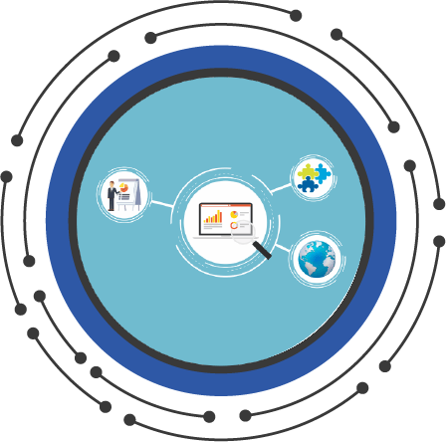







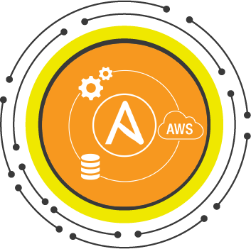





Our Trending Courses
• IOT & Machine Communication: IOT Basics, Intermediate & Advanced ; Artificial Intelligence ; IoT Analytics ; IIoT ; IoT Security ; Machine Learning ; Augmented Reality (AR) ; Natural Language Processing ; UIPath ; RPA
• Data Science: Data Science in Practice ; Data Science & BigData Analytics
• DevOps : Chef ; Puppet ; Docker ; Jenkins ; GIT ; Ansible ; Kubernetes ; ELK (Elastic, Logstash, Kibana )

Slide 7
Our Trending Courses
• Cloud Computing, BigData and Analytics: AWS Developer ; Architecting Solutions with AWS ; Developing Solutions with Microsoft Azure ; Spark & Scala ; Microservices ; Hadoop Developer and Admin ; Cassandra Developer & Admin ; MongoDB ; Cloud Foundry ; SAS ; Storm ; Tableau ; Qlikview ; Splunk ; Analytics with Excel ; Pig & Hive ; Oozi ; Zookeeper ; Kafka ; Impala ; Sqoop ; Ambari ; Analytics with R ; Python for Analytics ; PySpark

Slide 8
Our Trending Courses
• Traditional Databases and Server Technologies: Oracle DB Developer and Admin; Microsoft SQL Server ; MySQL ; Maria DB ; PostgreSQL; RIAK ; Oracle NoSQL ; CouchDB ; Sharepoint Admin, Developer & Migration; System Center ( SCCM, SCOM, etc ), Microsoft Exchange Server ; IBM Weblogic ; IBM Websphere ; Apache Tomcat ; Glassfish ; Pentaho ; Magento ;
• Mobile Technologies : Objective-C /Swift & iOS ; Android ; Titanium ; Robotium ; Hybrid App Dev

Slide 9
Our Trending Courses
• Java/J2EE: Core Java ; Java 8/9 ; RESTful WebServices ; Spring ; Spring Web ; Spring Cloud ; Spring Security ; Spring Boot ; Test Driven Development ; Design Patterns & Principles and more ; Secure Coding with Java ; XML ; OSGI ; Camel ; jUnit ; jMock ;
• Microsoft Technologies: C# ; ASP.Net ; MVC 3/4/5 ; WPF ; WCF ; PowerBI ; Hyper-V
• Programming Languages: Python ; Perl ; Shell ; Ruby ; Scala ; PHP ; C# ; C++ ; Core Java ; R

Slide 10
Our Trending Courses
• Cyber Security : Certified Cloud Security Professional, Information Systems Security Professional, Cyber Crime and Cyber Security
Crypto-Currency : BlockChain, Fabric, Ethereum, Hyper Ledger, Iroha, Indy, Chainscript, etc
Non-Technical Training : PMP, Agile, Scrum, PRINCE2, PgMP, Adv. Excel, Soft skills/behavioral, Leadership , Emotional Intelligence, Radical Thinking, Design Thinking, etc.

Slide 11
Delivered & Upcoming Trainings
Delivered Trainings
Dell/Nutanix Hyper-converged Solutions (2 batches)
Cisco Meeting Server Intermediate (Collab250)
Advanced DevOps
SpringBoot
Upcoming Trainings
Commvault Professional AP (V11)
HTML5
DevOps
GoLang

Slide 12






















Few of Our Proud Clients

Slide 13

























Few of our Customers

Slide 14
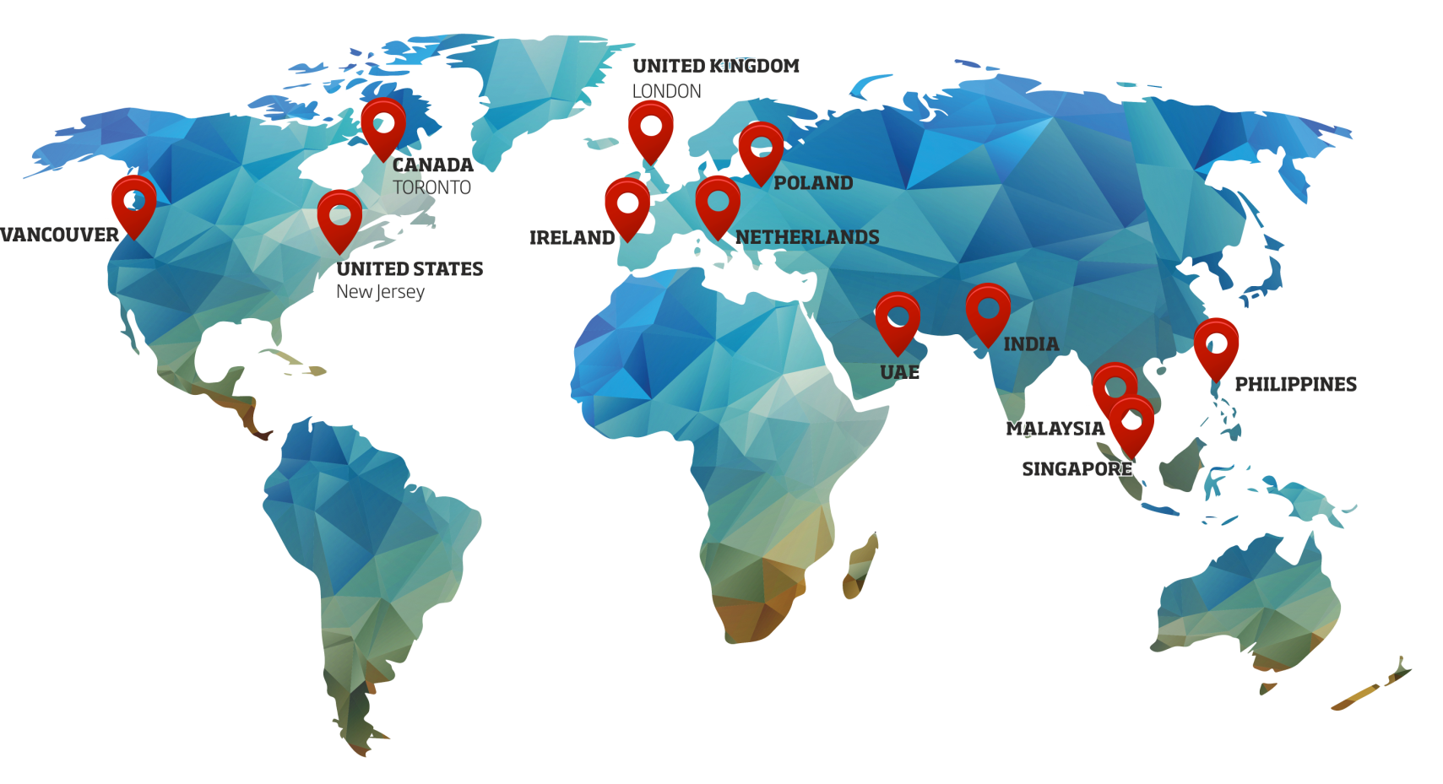
Our Global Presence

Slide 15









Why Choose Cognixia?
Excellent Quality Training,
optimized batch size
Wide range of
Technical, Functional
and Behavioral courses
State-of-the-Art
infrastructure
Expert Trainers who
are SMEs and
technocrats
Lifetime 24 X 7 LMS
(Learning Management
System) access
Practical,
in-depth knowledge
Live moderator support
throughout the program
Dedicated Cluster
Access to specific
courses
Measurable benefits
gauged through tracking
and monitoring tools

Slide 16








Why Choose Cognixia?
Curriculum review and inclusions for Educational Institutions
Tracking and evaluation of learner’s progress
Our certification is recognized worldwide
Competitive Rates and customized quotes for enterprise trainings
Choice of learning modes: Self paced, Online, Classroom and Blended learning
Cognixia Certification upon course completion
Value Addition to Partner Educational institutions through our brand
Customized and tailored programs for Corporates

Slide 17

How we help you succeed
Improve the performance, employee retention and increase capability of human resources in organizations
Provide Cognixia certified professionals, skilled in emerging technologies
Certify professionals in emerging technologies via globally recognized certification
Upgrade the academic ecosystem and provide better career opportunities to students and freshers

Slide 18
For more information or to set up an appointment, kindly contact us today. bdg@cognixia.com

